Slide 1
Mary & John Geisse Soccer Complex at Eagle Creek Park
Public Meeting #3
Dec. 12, 2024

Slide 2
Agenda
Introductions
Don Colvin – Deputy Director
Andre Denman – Principal Planner
Brittany Davis – Park Manager
Designer
Michael Krosschell of Weihe Engineers
Background
Progress to Date
Improvements
Schedule
Questions

Slide 3
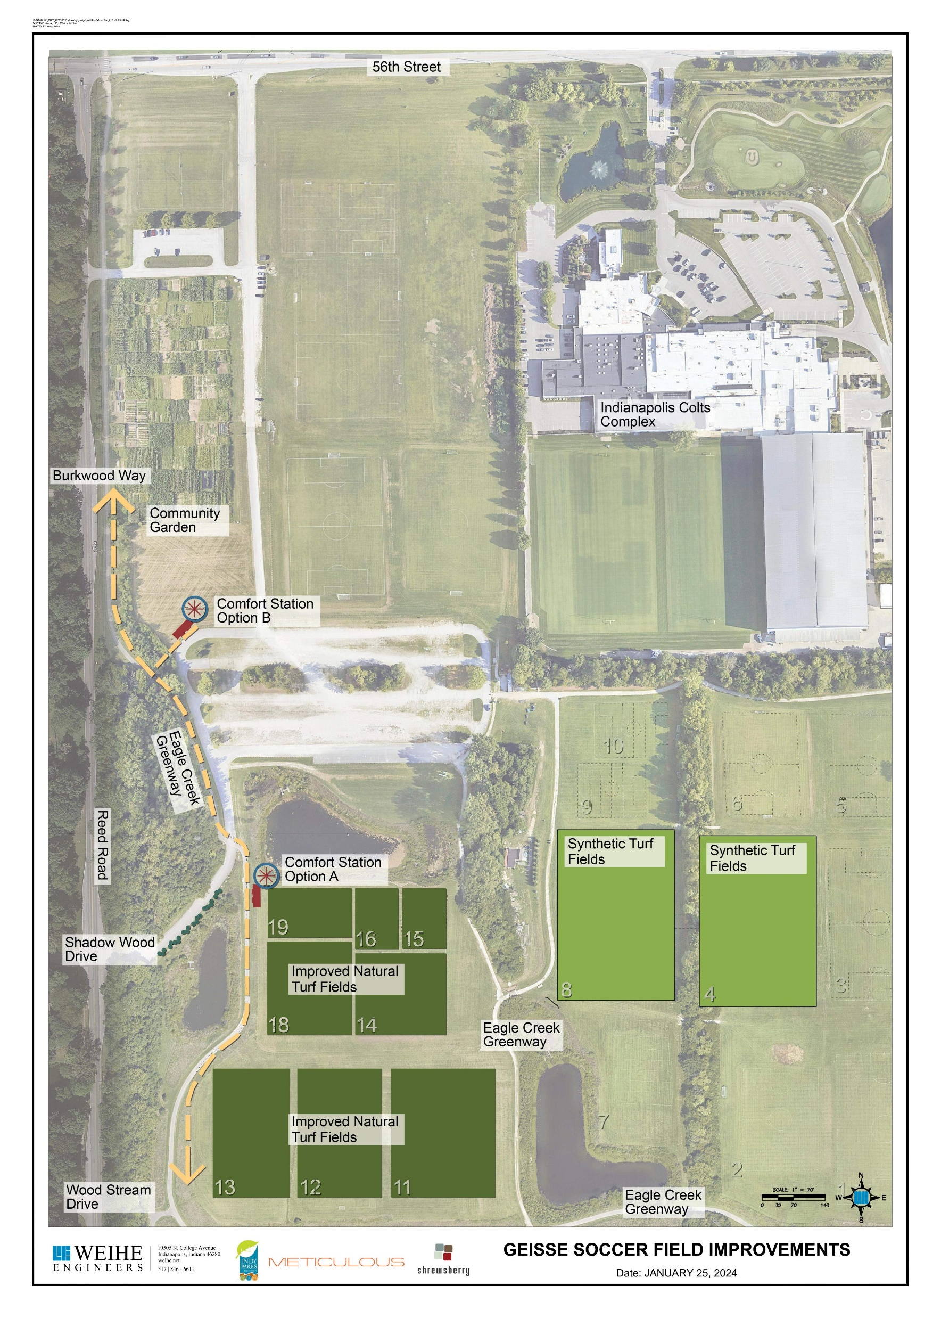
Background
Lilly Endowment Grant included field and restroom improvements.
Locations A and B were not preferred by neighbors.
Parks completed sports field improvements and deferred restroom building.

Slide 4
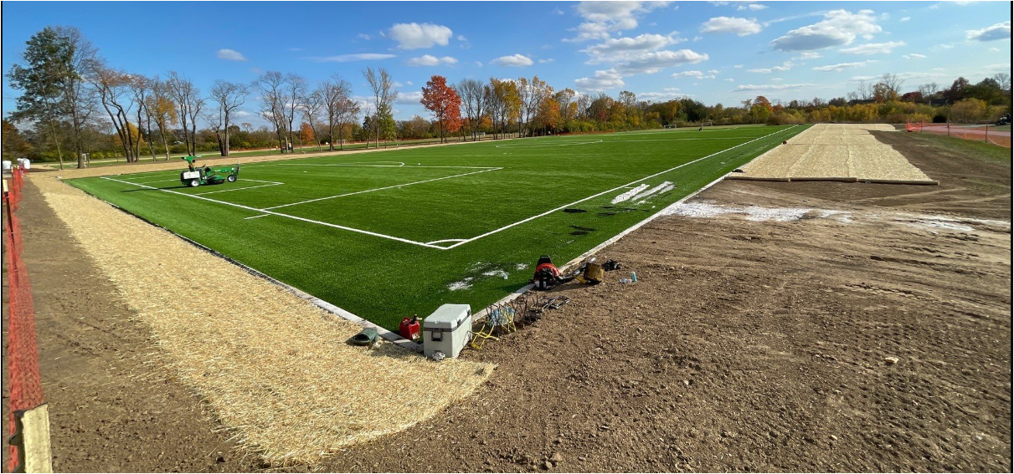
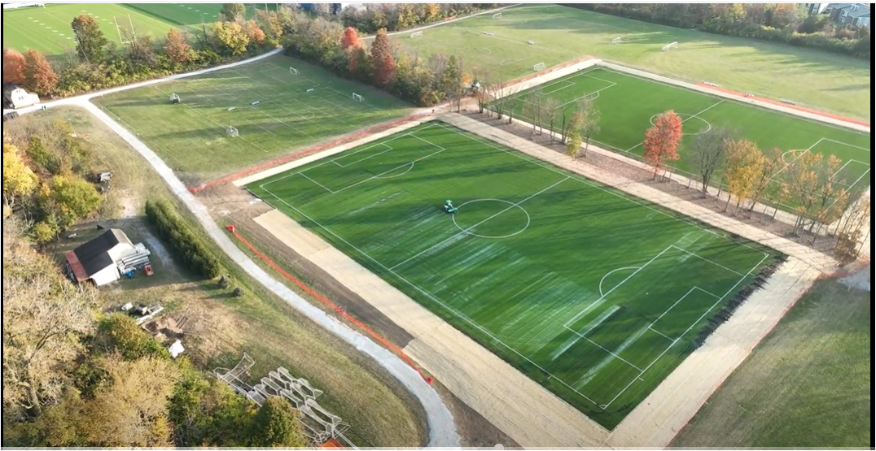
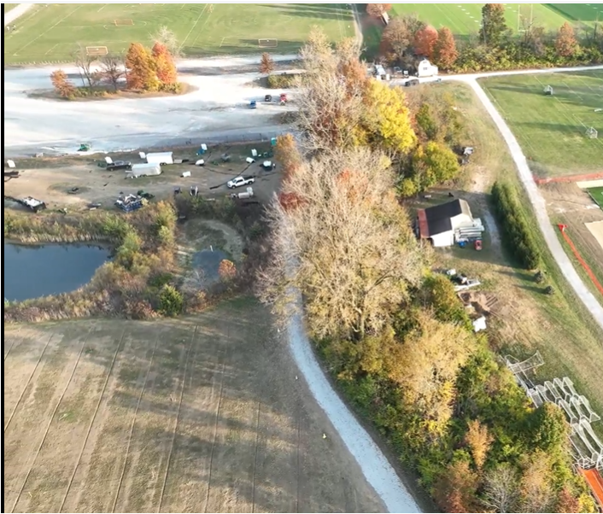
Progress to Date

Slide 5
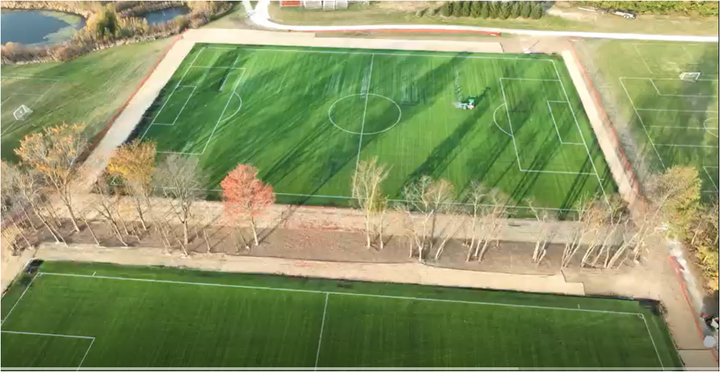
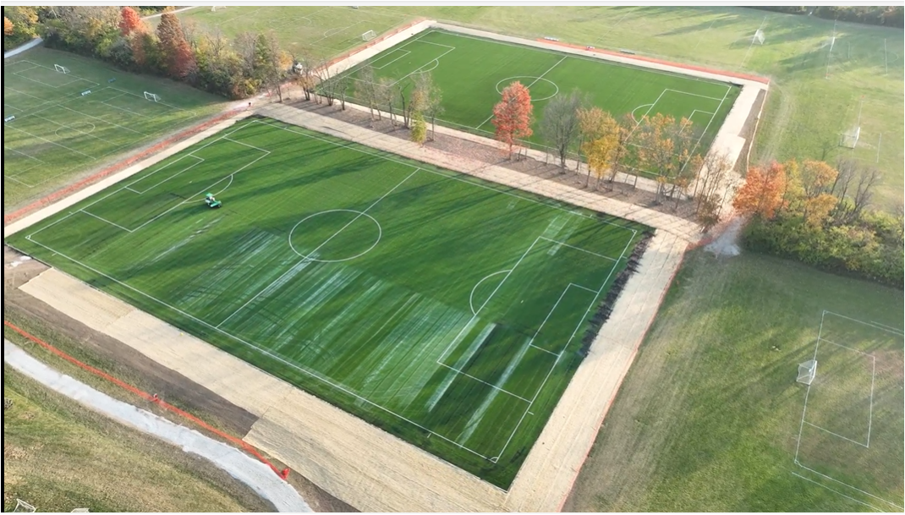
Progress to Date Cont.

Slide 6
Site Plan

Slide 7
Enlarged Site Plan

Slide 8
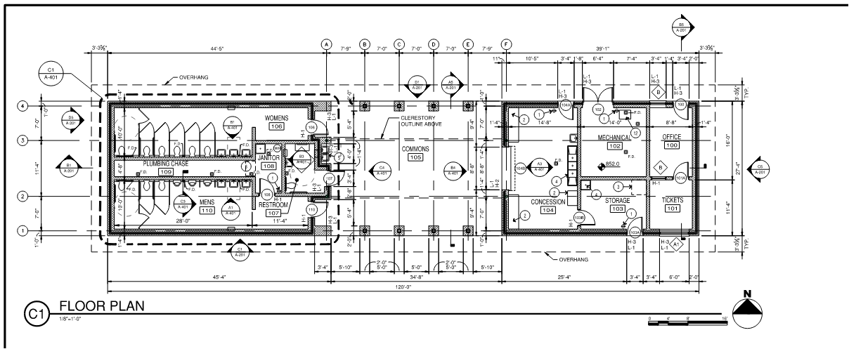
Restroom Floorplan (27ft x 120ft)

Slide 9
Restroom
Includes:
restrooms,
mechanical room,
storage,
office,
concessions, and
support space.

Slide 10
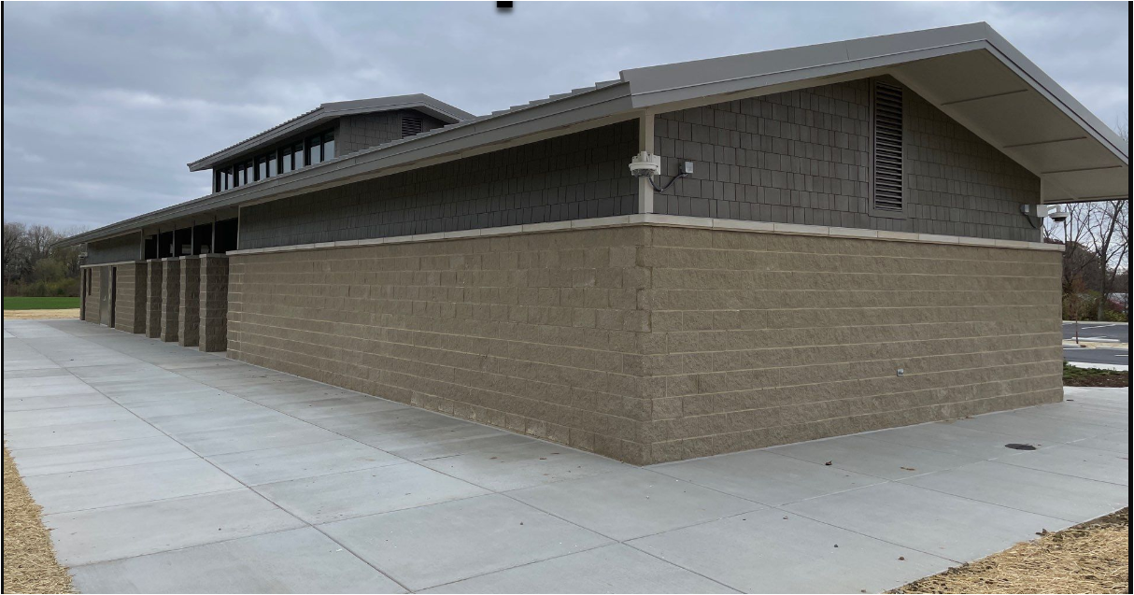
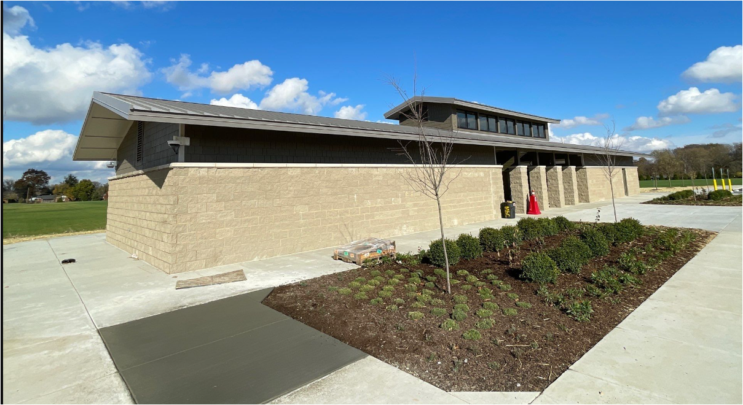
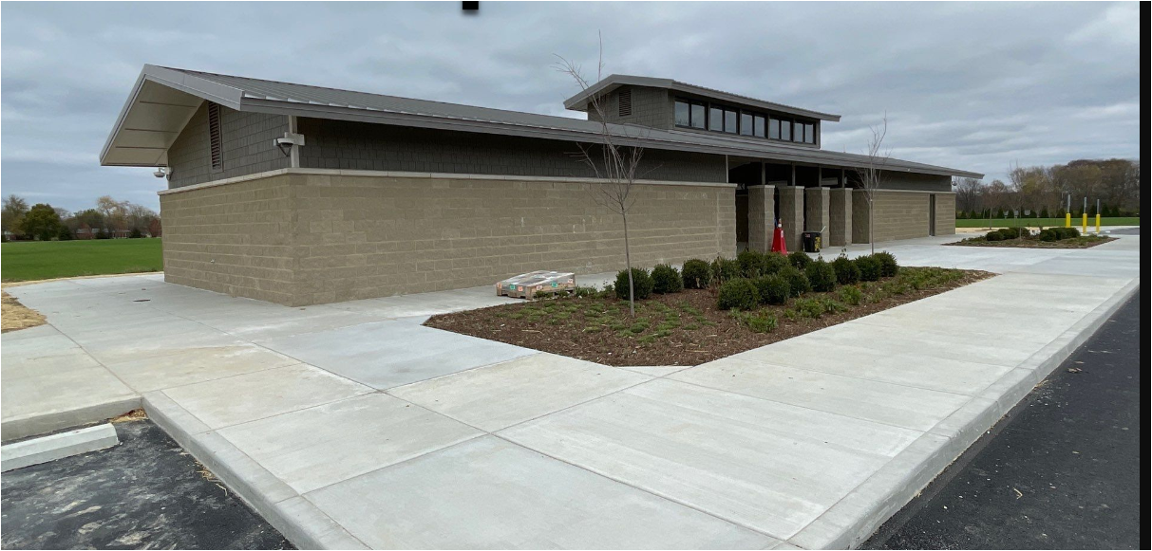
Restroom
example

Slide 11
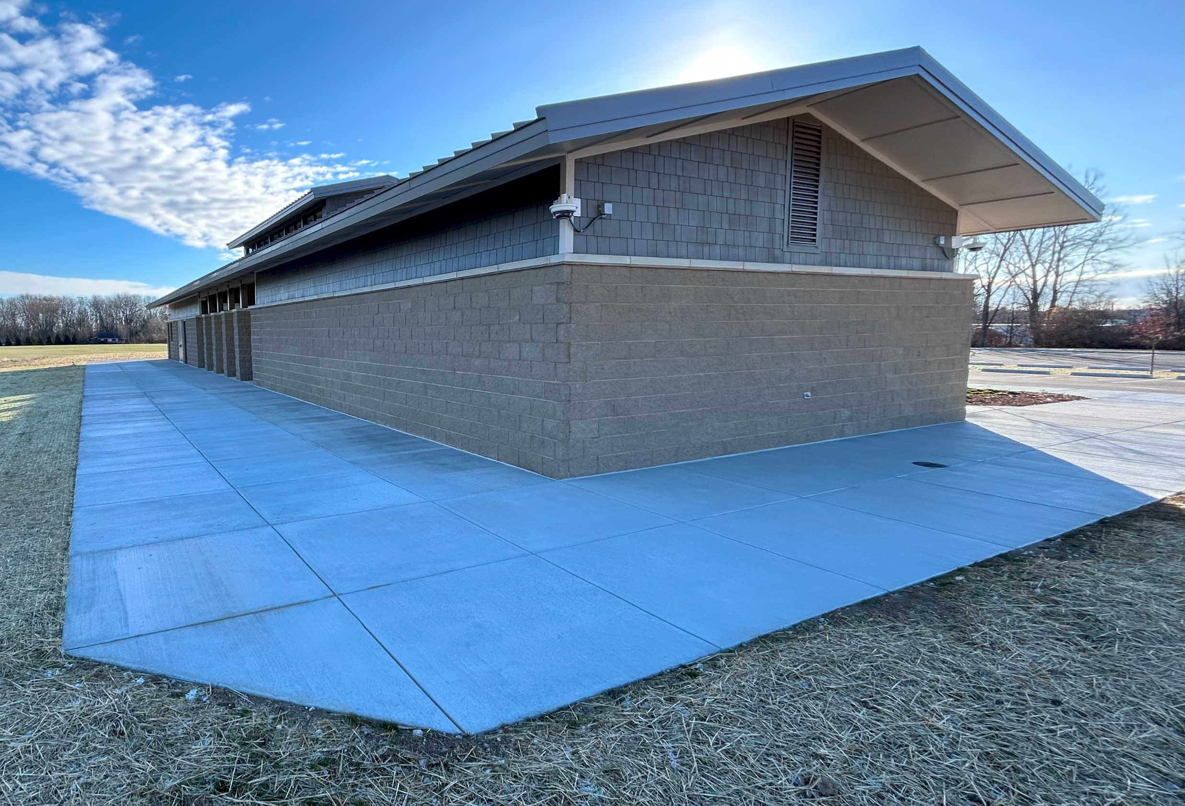
Restroom
example

Slide 12
Restroom
example

Slide 13
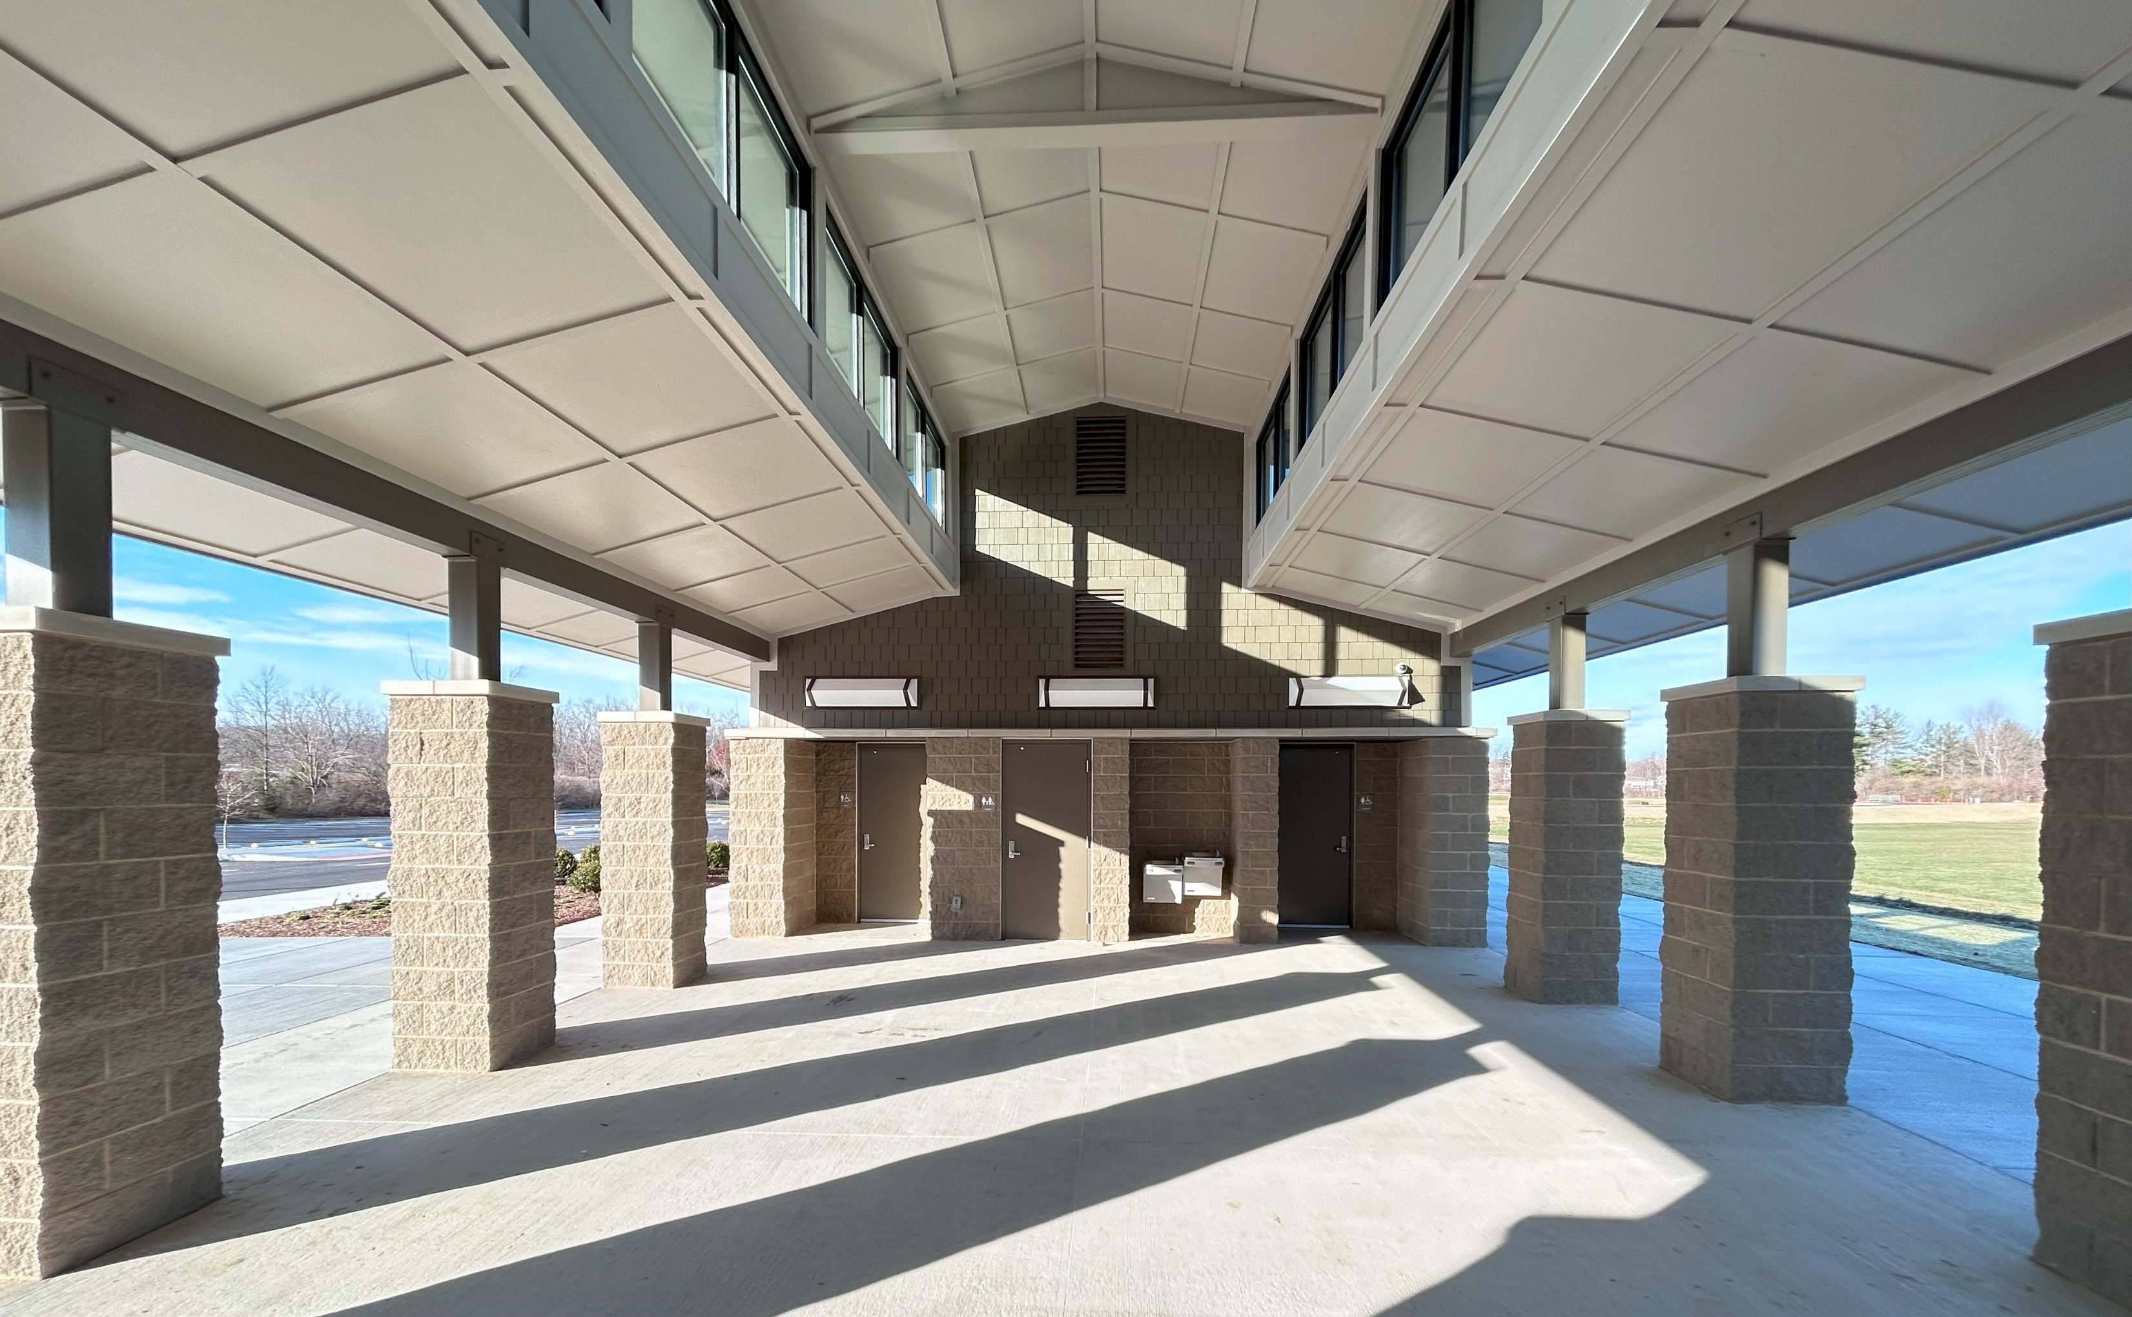
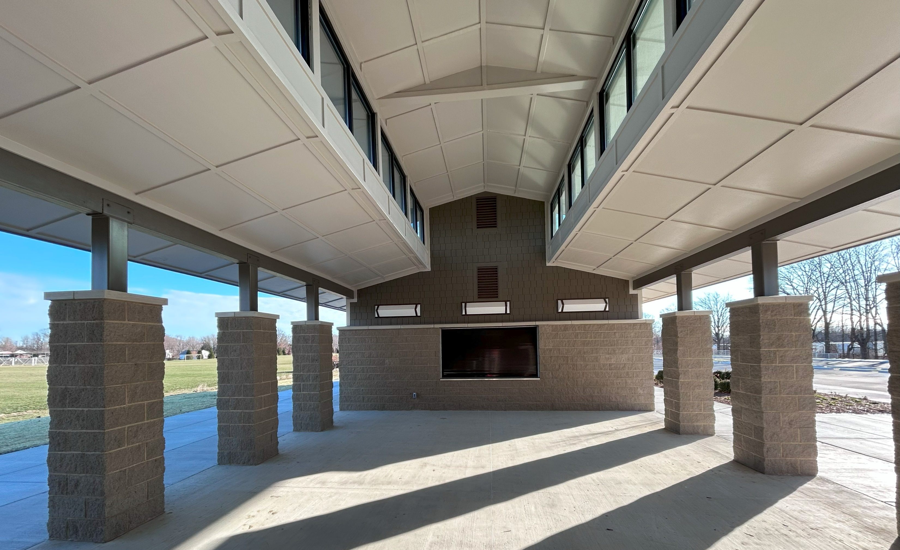
Restroom example

Slide 14
Restroom
example

Slide 15
Schedule
Design – spring/summer 2025
Bidding – fall/winter 2025
Groundbreaking/Construction Commences – spring/summer 2026
Substantial Completion – fall/winter 2026
Final Completion – fall/winter 2026
Ribbon Cutting – TBD

Slide 16
QUESTIONS?

