Slide 1
Graham Edward Martin Park
Public Meeting #1
Dec. 5, 2024

Slide 2
Agenda
Introductions
Background
Scope
Grading Plan
Clay Cap
Preliminary Schedule
Questions

Slide 3
Introductions
Indy Parks
Don Colvin – Deputy Director, Parks & Planning
Andre Denman – Principal Park Planner
Julee Jacob – Sr. Project Manager, Special Programs
Design / Engineering / Environmental
Program Management

Slide 4
Background
"… a man who championed fairness for people from all walks of life"
(HVAF)
Established 1979
67 acres
Formerly Fall Creek & 16th Park
Renamed in 2011 to honor Lt. Graham Edward Martin
One of the first African Americans to become an officer in the United States Navy
Graduate of Crispus Attucks High School, Indiana University and Howard University
Crispus Attucks HS varsity football and baseball coach from 1947-1982

Slide 5
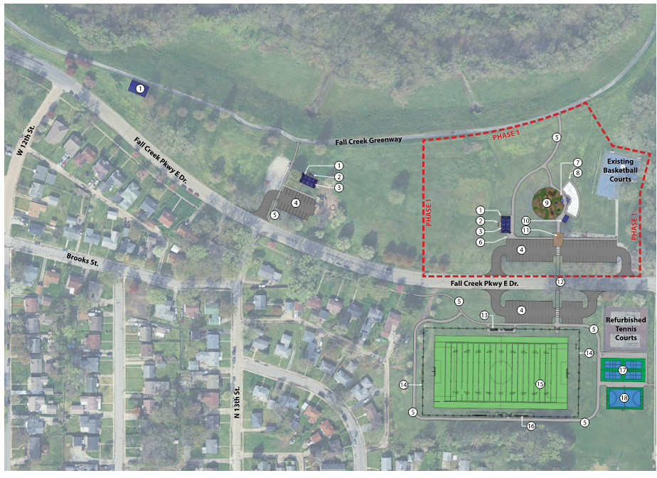
Site Plan
LEGEND
Picnic Shelter
Grill and Hot Coal Barrel
Picnic Tables
Parking
Walkway /Trail
Bike Rack
Shade Canopy
Splashpad
Playground
Comfort Station
Graham E. Martin Memorial Plaza
Crosswalk
Spectator Bleacher
Fence
Multi-Use Field
Player Bench
Pickleball Courts
Futsal Court
W. 16th Street

Slide 6
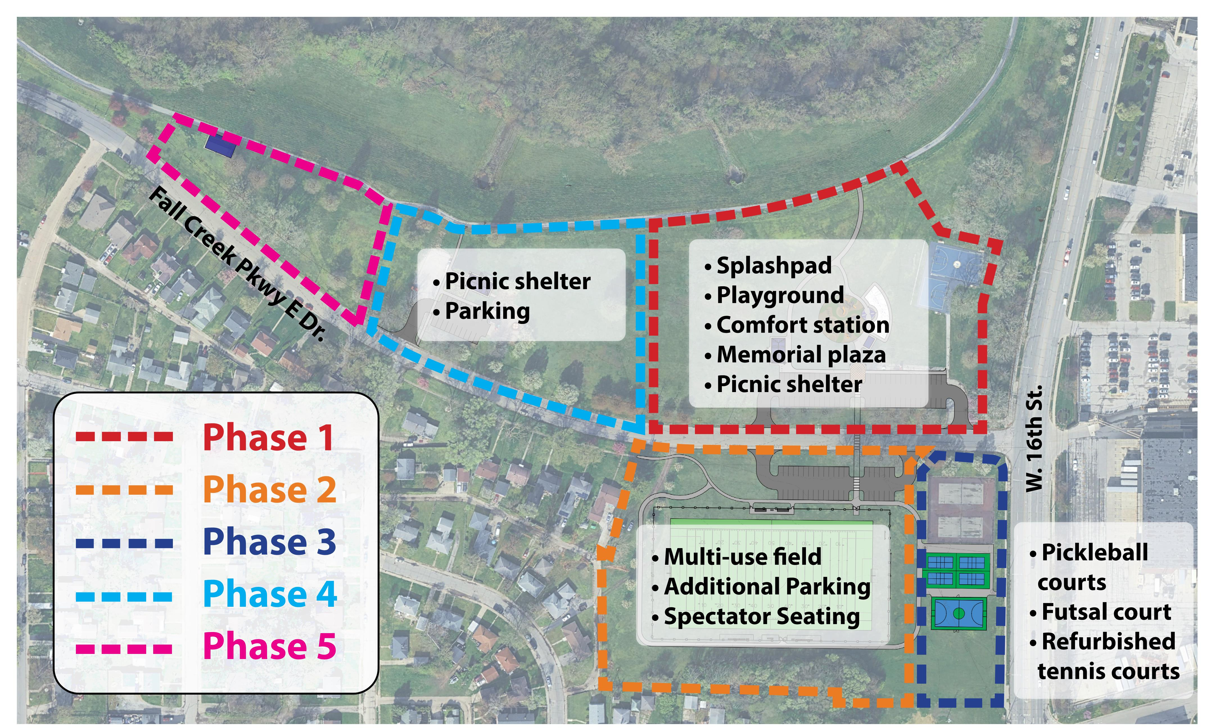
Phases
Phase 1- Lilly Endowment Grant funded improvements include:
new playground
splash pad
comfort station
Memorial plaza
Picnic Shelter
Future phases include:
Improved/expanded hardcourts
multipurpose sports field
walking path
expanded parking

Slide 7
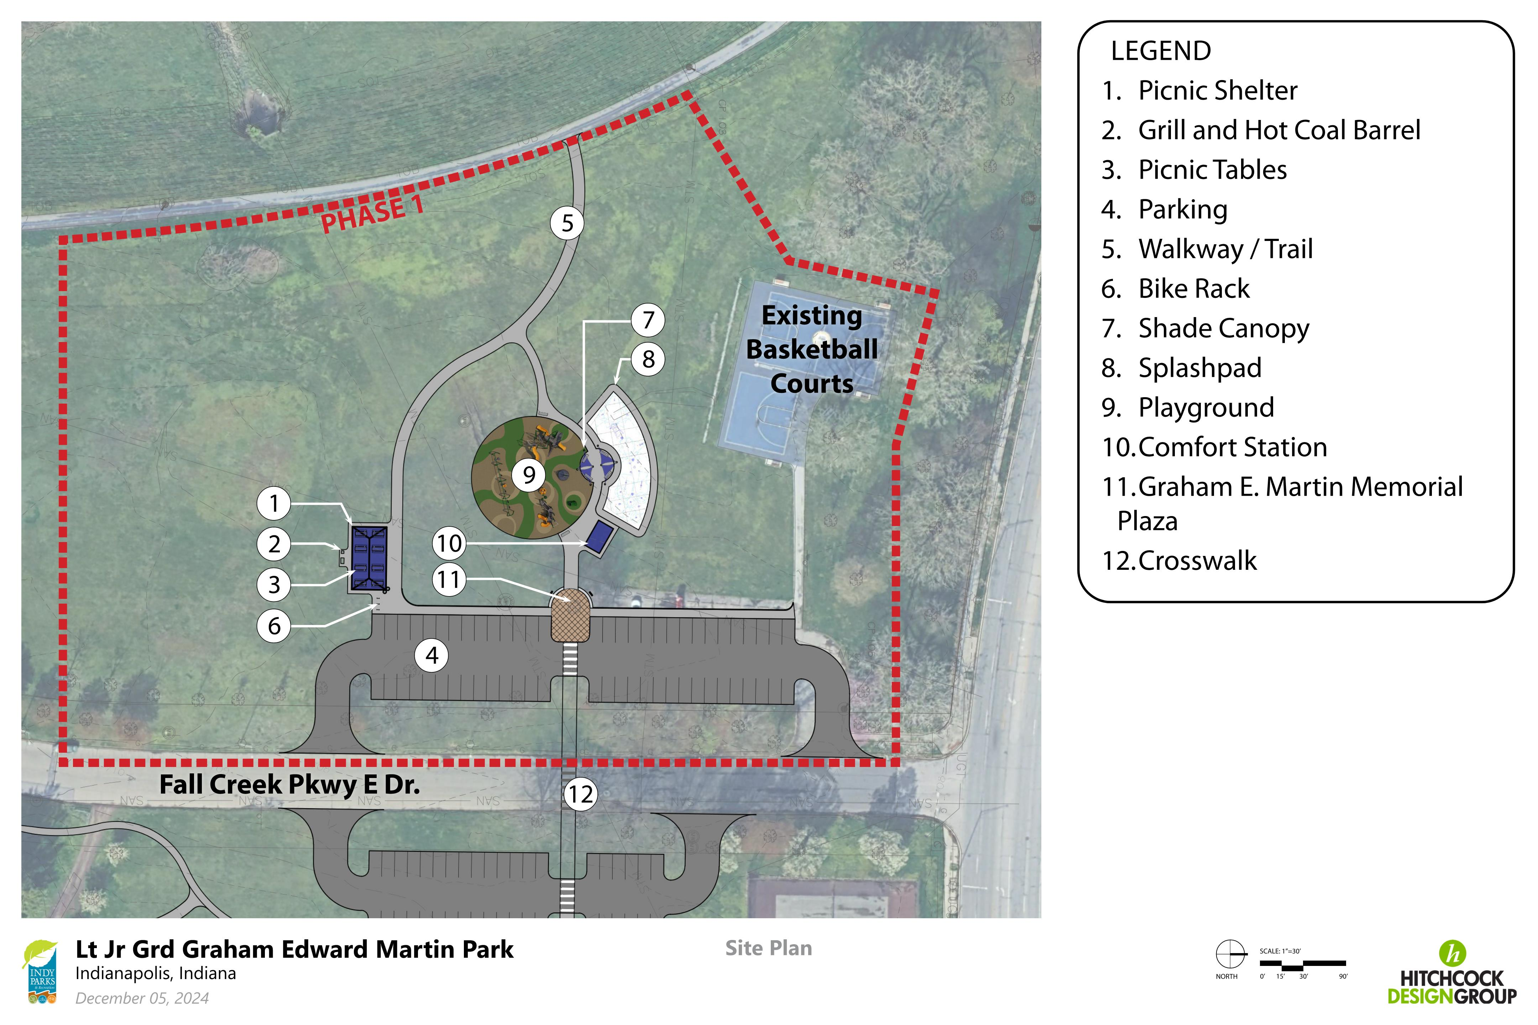
Phase 1
LEGEND
Picnic Shelter
Grill and Hot Coal Barrel
Picnic Tables
Parking
Walkway /Trail
Bike Rack
Shade Canopy
Splashpad
Playground
Comfort Station
Graham E. Martin Memorial Plaza
Crosswalk
W. 16th Street

Slide 8
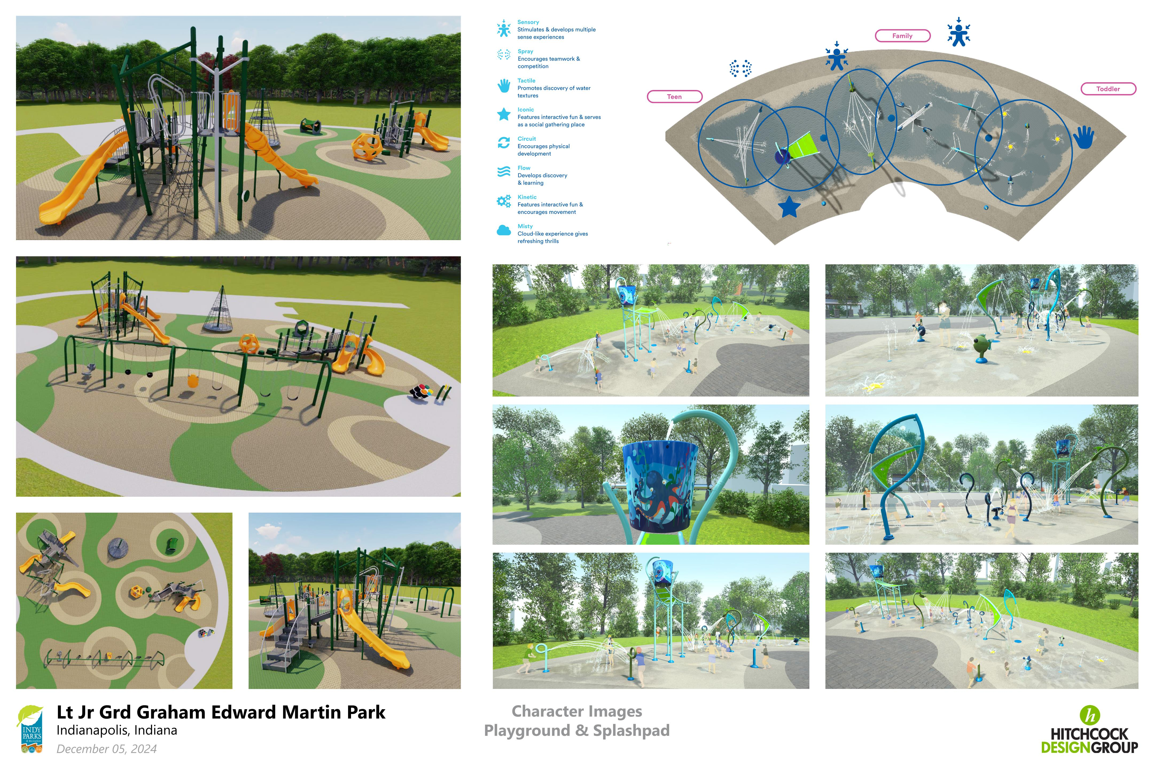
Splash Pad & Playground Design
Part of Phase 1

Slide 9
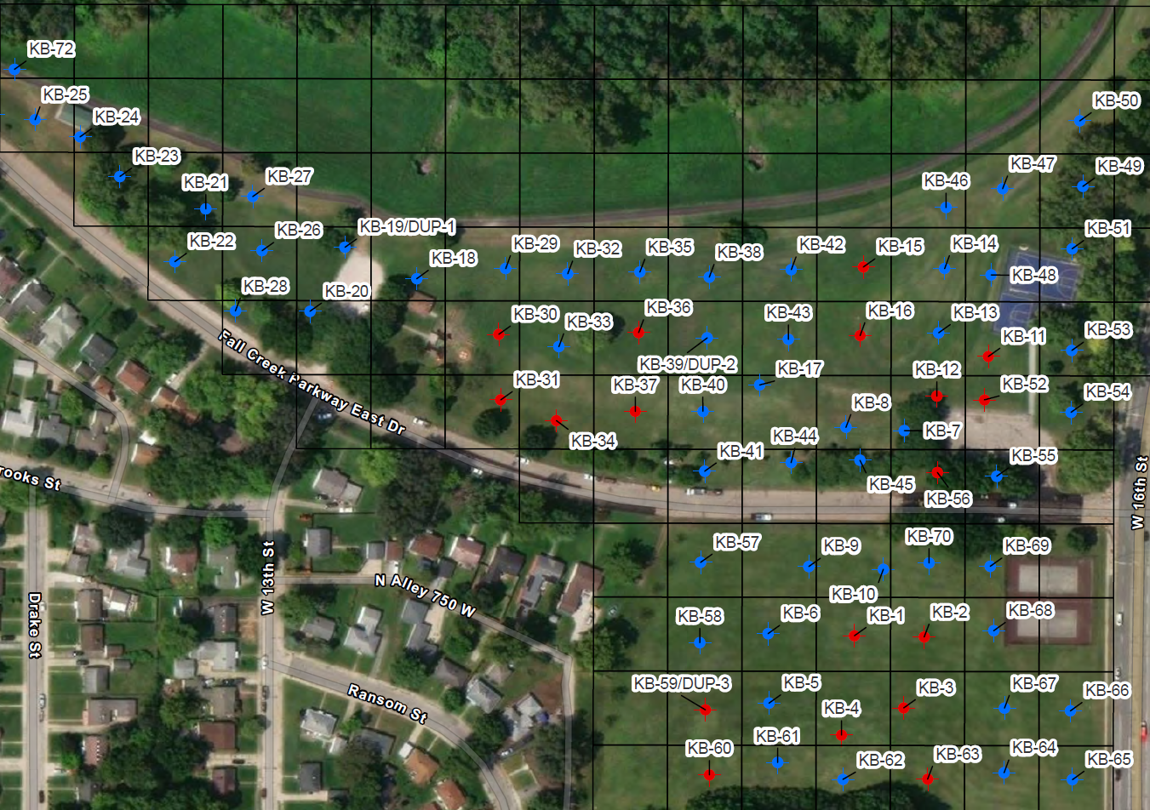
Environmental Assessment
LEGEND
Site Investigation Boundary
No Exceedances
Recreational Limits Exceedance
Prior to being developed as a park, the site was mined for aggregate.
The area was filled in overtime with fill material; a common practice at the time.
The type of fill material used is now considered unacceptable.
Environmental investigations were done with soil samples collected.
Results show some areas have metals and some polycyclic aromatic hydrocarbons (PAHs) above the state regulatory limits for recreational sites.
PAHs occur naturally in coal, crude oil, gas, and other products.

Slide 10
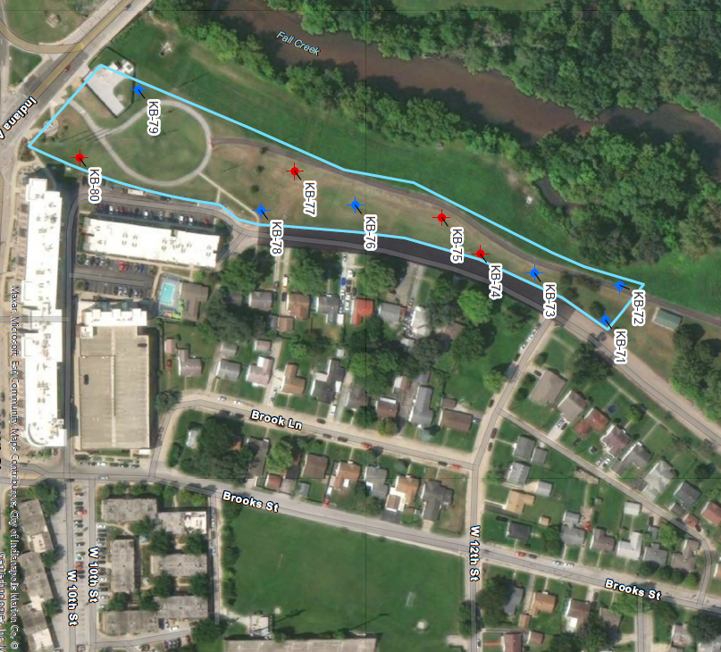
Environmental Assessment
LEGEND
Site Investigation Boundary
No Exceedances
Recreational Limits Exceedance

Slide 11
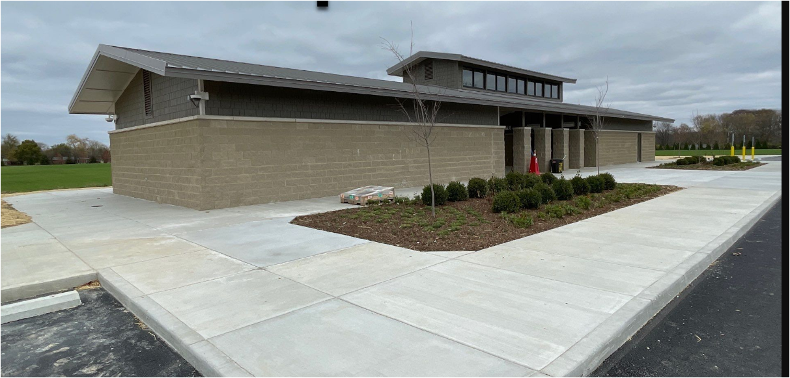
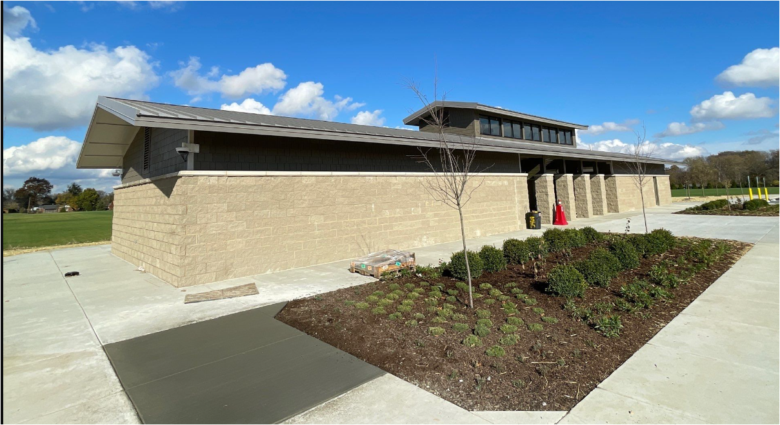
Clay Cap

Slide 12
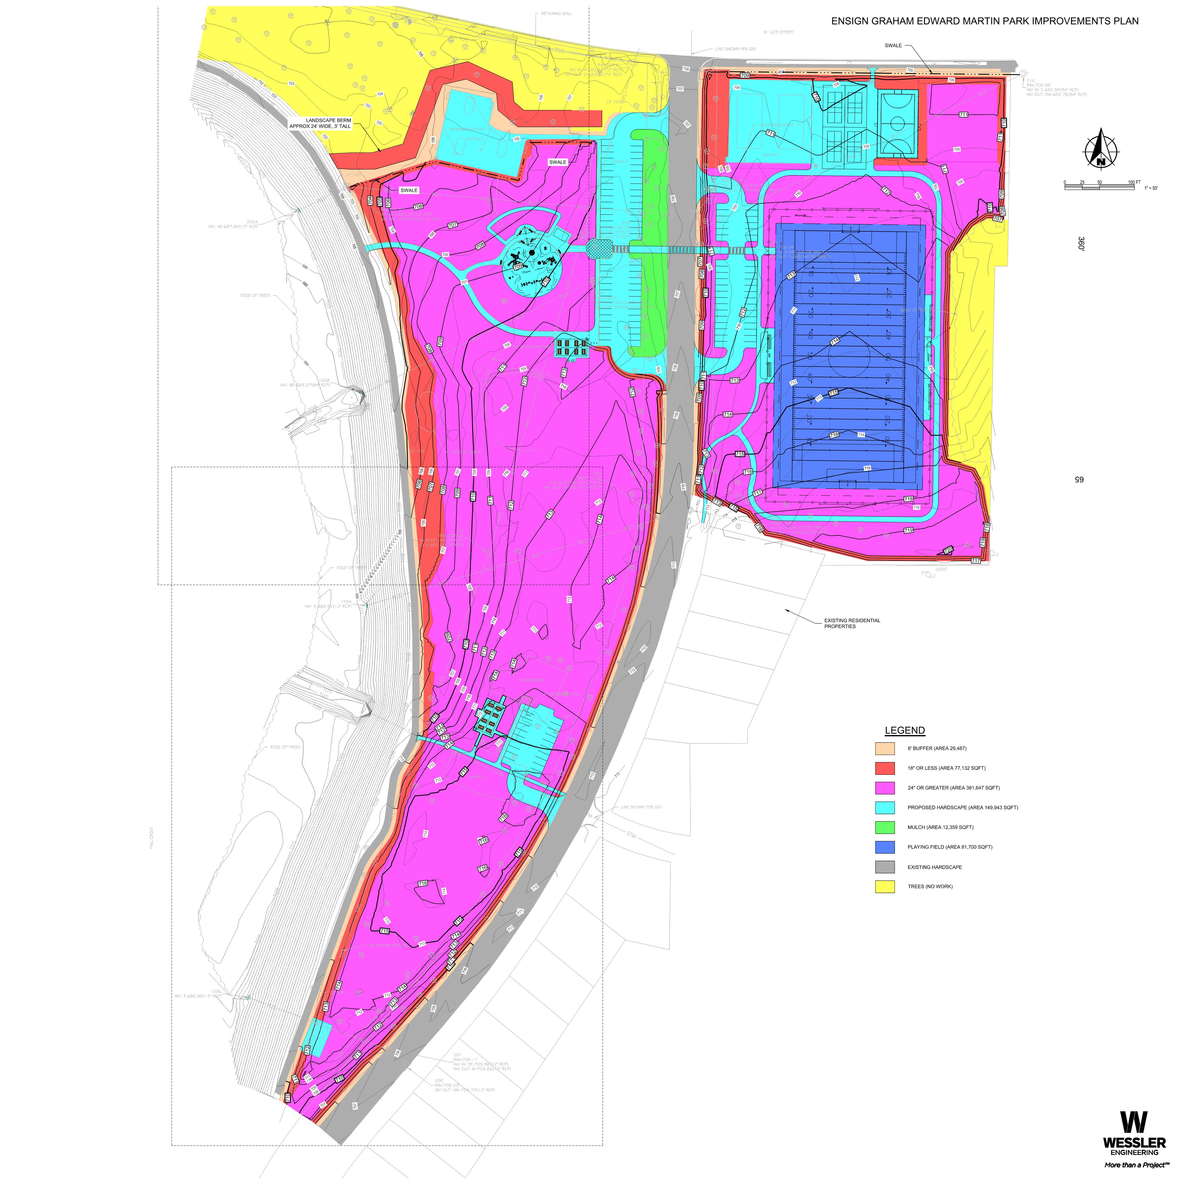
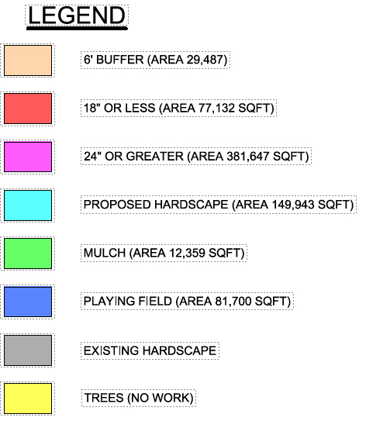
Grading
Plan
W. 16th Street

Slide 13
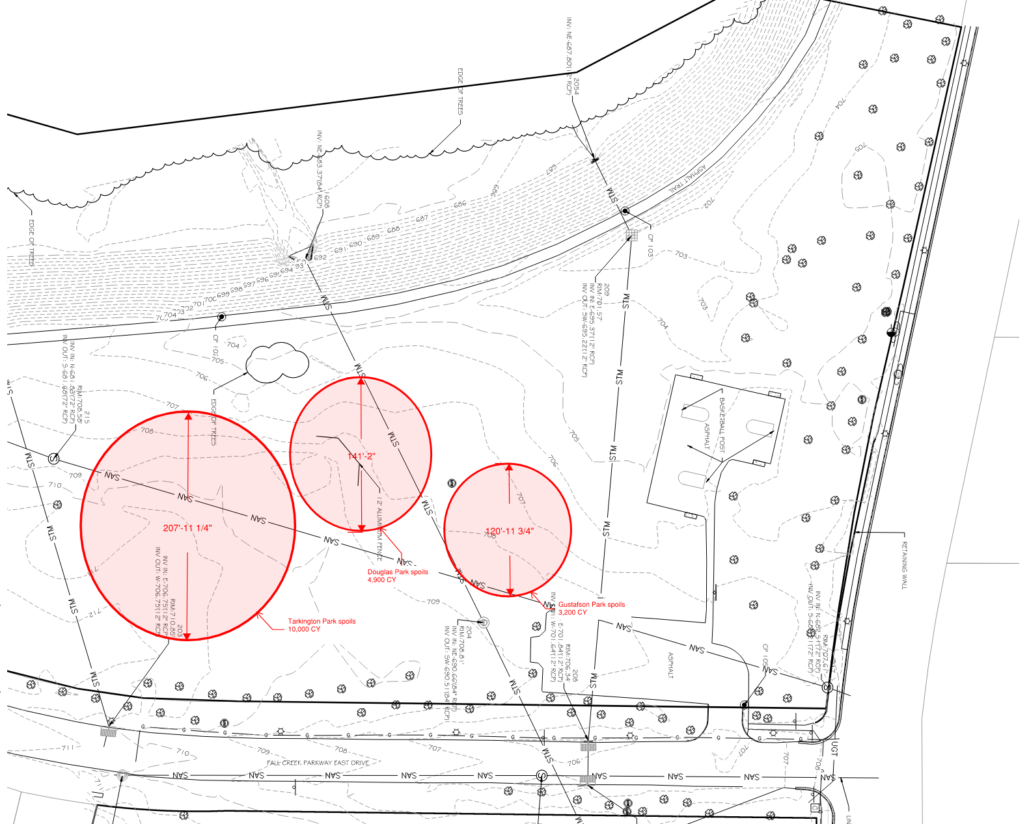
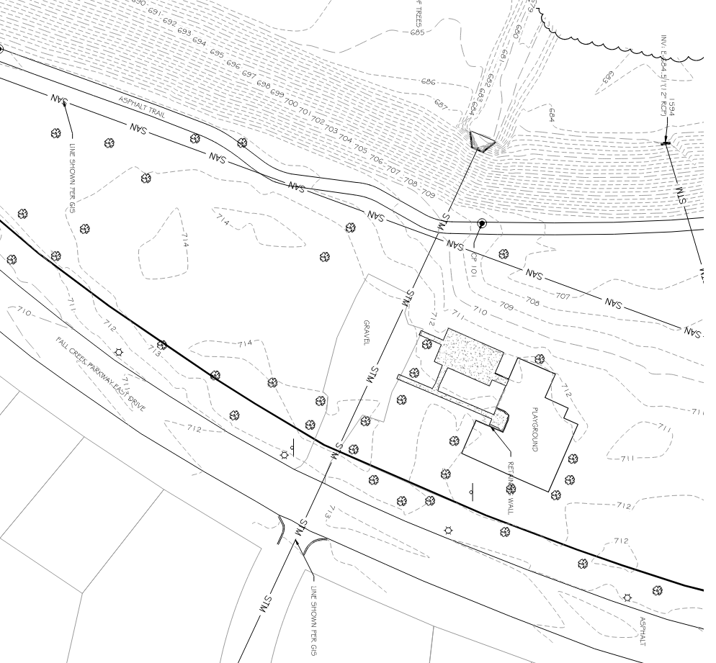
In next few months
Clean Soil Stockpile
W. 16th Street
W. 16th Street

Slide 14
Preliminary Schedule
Estimated project timeline
Design Complete: Q1 2025
State & Local Permitting: Q2-Q4 2025
Bidding & Contract Award: Q1 2026
Groundbreaking: Q1 2026
Phase 1 Construction Complete: ~Fall 2026

Slide 15
QUESTIONS?

